Slide 1
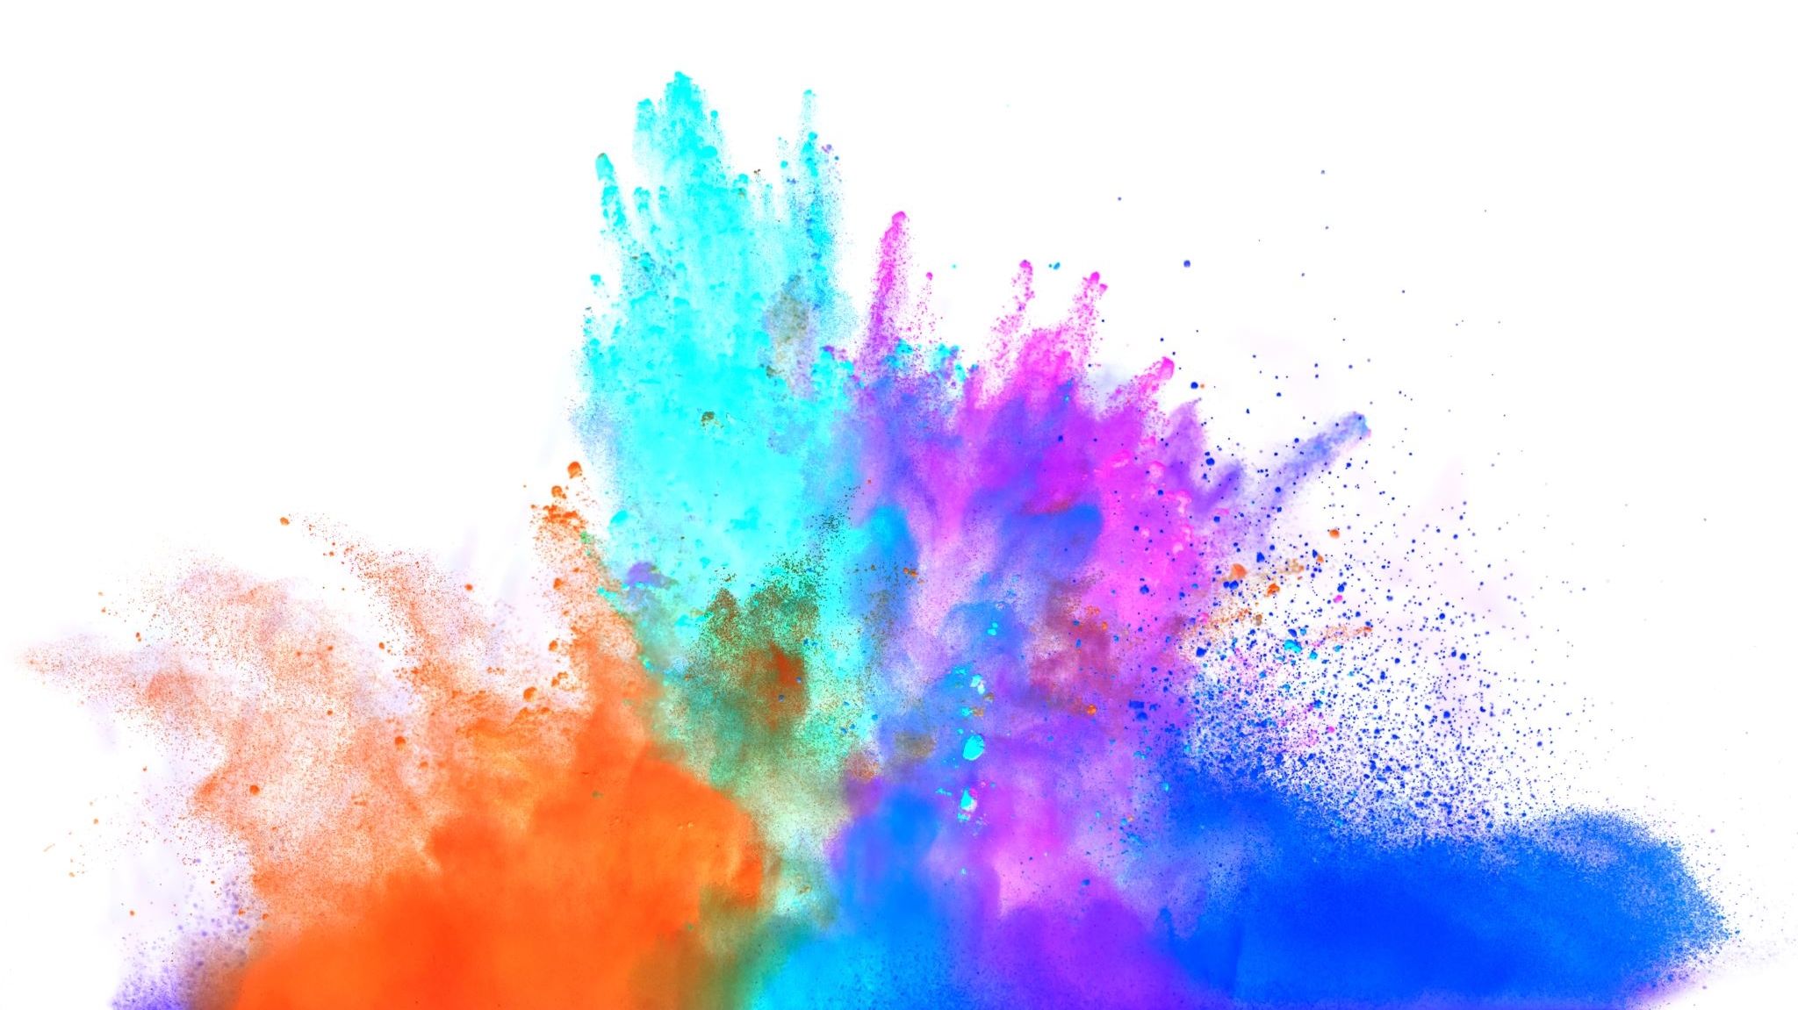
StegoChat: A Secure Communication System Using Encryption and Steganography
Xingzhi Li（z5527197）T18B COMP6441 Project Video

Slide 2
What is StegoChat?
A local platform integrating front-end and back-end components for information encryption and steganography that:
Encrypts messages using AES-256 (CBC)
Hides ciphertext in images (PNG), video (MP4), and audio (WAV) using LSB steganography
Offers both CLI and Flask Web UI
Evaluates image quality using PSNR

Slide 3
Why Did I Build StegoChat?
Real-World Motivation: Visibility Can Still Be Dangerous
In 2024, a Chinese student in Sydney was targeted by phone scammers and manipulated into cutting contact with family. She was later found safe, but only after a national search triggered by her apparent disappearance.
Authorities revealed she had been communicating digitally throughout the incident, under the scammers’ control.
What Problem Does StegoChat Solve?
Encrypts with AES-256
Hides messages invisibly in images, videos, or audio carriers using LSB steganography
Runs fully offline — no trace, no metadata, no visibility
Dual security protection of 'not being understood' and 'not being seen'

Slide 4
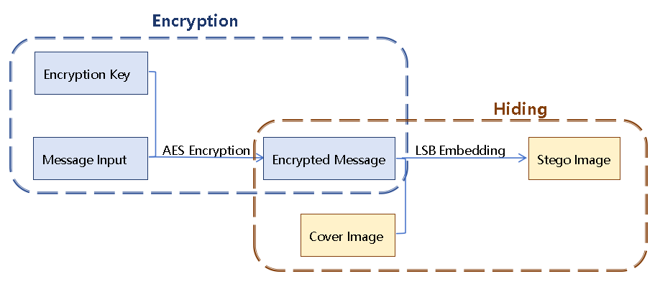
System Design & Features
System Flow Diagram:

Slide 5
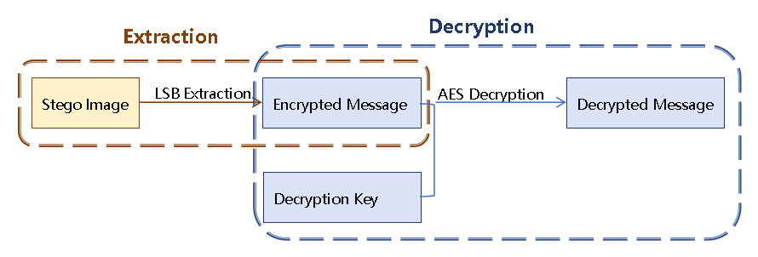
System Design & Features
System Flow Diagram:

Slide 6
Demonstration
Demo Video on YouTube

Slide 7
Security Analysis (CIA Triad)
Confidentiality: Achieved through AES-256 encryption, ensuring messages remain unintelligible even if extracted.
Integrity: The system does not alter message content during embedding or extraction. Extraction either succeeds fully or fails with explicit error feedback.
Availability: Fully local implementation ensures system availability without dependence on external servers. Redundant carrier formats (image, video, audio) increase resilience.

Slide 8
Challenges & Solutions
Challenge | Solution
Carrier too small | Auto resizing + length check
Frame disorder in video | Frame index tracking
AES decoding errors | UTF-8 fix + padding validation
UI theme bugs | Debugged hex vs RGB colour mismatch
Extra Points:
First time using Flask + CSS
All code was written from scratch
Frequent testing for edge cases (empty input, long text, corrupted files)

Slide 9
Results & Reflection
What I Built & Learned
Fully working local platform for secure media-based messaging
Robust implementation of encryption + steganography
Learned full-stack dev (Flask, HTML, CSS, OpenCV, Pillow)
Enhanced debugging, testing, exception handling skills
Would add HTTPS + remote deployment if extended

Slide 10
Thanks for watching!

